Slide 1

Peter Smagorinsky
Pubs Crawling:
A Thematic Overview

Slide 2
Table of Contents
Practice-oriented Books
Practice-oriented Articles and Chapters
Teacher Education & Development: Books
Teacher Education & Development: Research Reports
Teacher Education: Conceptual Papers
Books on Vygotsky
Research on Literacy, broadly speaking: Books
Research on Literacy, broadly speaking: Articles and Chapters
Writing Research: Books
Writing Research: Articles and Chapters
Research on Nonverbal Composing
The Teaching and Learning of Literature
Social Processes In and Out of Classrooms
Research Methodology: Articles and Chapters
Mental Health
Service-Learning
Character Education
Policy and Standards Publications
Autobiographical Essays
Biographical Essays
Book Forewords
Public Essays
Book Reviews
Podcasts, Lectures, and Interviews
Fiction and Satire
English Today Magazine

Slide 3
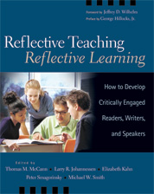
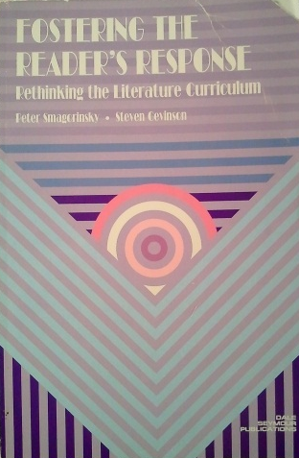
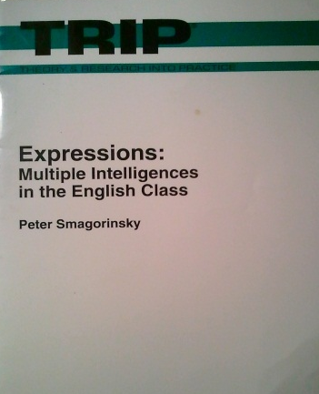
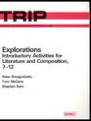
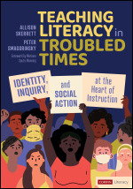
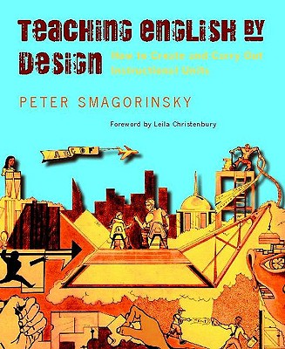

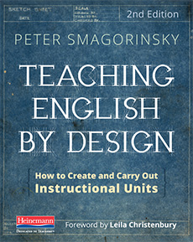
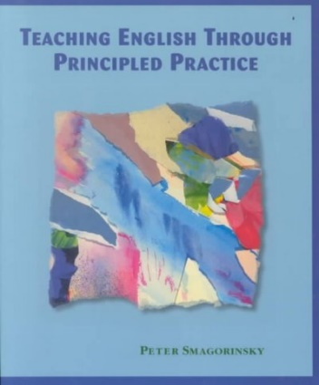
Practice-Oriented Books
Notes:
Practice-Oriented Pubs

Slide 4
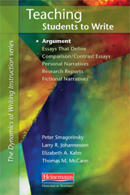
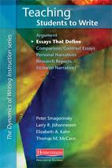
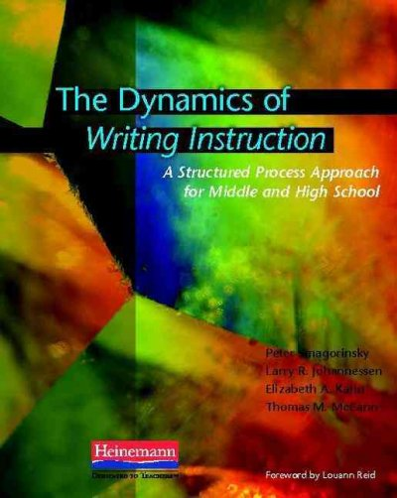
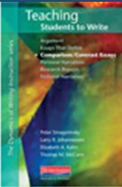
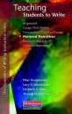
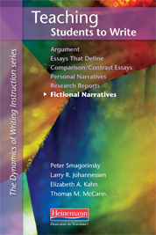
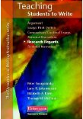
Practice-Oriented Books
(continued)

Slide 5
Practice-Oriented Articles and Chapters
Smagorinsky, P., & Slaby, J. (1986). A vocabulary bonus. Illinois English Bulletin, 73(2), 52-55.
Smagorinsky, P. (1989). Small groups: A new dimension in learning. English Journal, 78(2), 67-70.
Smagorinsky, P. (1990). Developing the social conscience through literature. In P. Phelan (Ed.) Literature and life: Making connections: Classroom practices in the teaching of English, Vol. 25 (pp. 13-18). Urbana, IL: National Council of Teachers of English.
Smagorinsky, P. (1991). The aware audience: Role-playing peer response groups. English Journal, 80(5), 35-40.
Smagorinsky, P. (1991). Writing across the curriculum: Do writing skills really transfer from class to class? Oklahoma English Journal, 5(2), 48-56.
Smagorinsky, P. (1992). Reconfiguring the English class through multiple intelligences. In J. Collins (Ed.), Vital signs 3: Restructuring the English class (pp. 35-44) Portsmouth, N.H.: Heinemann.
Smagorinsky, P., & Fly, P. K. (1992). How teacher-led discussions affect small group processes. Oklahoma English Journal, 7(1), 5-15.
Smagorinsky, P. (1993). Preparing students for enriched reading: Creating a scaffold for literary understanding. In G. E. Newell & R. K. Durst (Eds.) Exploring texts: The role of discussion and writing in the teaching and learning of literature (pp. 153-174). Norwood, MA: Christopher-Gordon Publishers.
Smagorinsky, P. (1994). Bring the court room to the classroom: Develop civic awareness with simulation activities. The Social Studies, 85, 174-180.
Smagorinsky, P., & Fly, P. K. (1994). A new perspective on why small groups do and don't work. English Journal, 83(3), 54-58.
  Reprinted in: Milner, J., & Milner, L. (Editors) (1999). Bridging English (2nd edition). Merrill/Prentice Hall.
  Roberts, P. (Editor) (1998). Harcourt Brace Sourcebook for Teaching Writing. Harcourt Brace College Publishing.

Slide 6
Practice-Oriented Articles and Chapters (continued)
Smagorinsky, P. (1995). Multiple intelligences in the English class: An overview. English Journal, 84(8), 19-26.
Smagorinsky, P. (1995). Striving for kinship within diverse communities. English Leadership Quarterly, 17(1), 7-9.
Smagorinsky, P. (1996). Grammar, dialect, second language acquisition, and writing: An annotated bibliography. Oklahoma English Journal, 10(2), 31-36.
Smagorinsky, P. (1996). Multiple intelligences, multiple means of composing: An alternative way of thinking about learning. NASSP Bulletin, 80(583), 11-17.
Smagorinsky, P. (1997). Entering the electronic conversation. English Journal, 86(4), 80-84.
Smagorinsky, P. (1997). Teacher-research as a way of life. Oklahoma English Journal, 11(2), 26-30.
Smagorinsky, P. (1999). The world is a stage: Dramatic enactment as response to literature. In B. J. Wagner (Ed.), Building moral communities through drama (pp. 19-38). Stamford, CT: Ablex.
McCann, T. M., Johannessen, L. R., Kahn, E., Smagorinsky, P., & M. W. Smith, M. W. (2005). Preface. In T. M. McCann, L. R. Johannessen, E. Kahn, P. Smagorinsky, & M. W. Smith (Eds.), Reflective teaching, reflective learning: How to develop critically engaged readers, writers, and speakers (pp. xxiii-xxv). Portsmouth, NH: Heinemann.
Ragsdale, D. A., & Smagorinsky, P. (2005). The role of play and small-group work in activity-based instruction. In T. M. McCann, L. R. Johannessen, E. Kahn, P. Smagorinsky, & M. W. Smith (Eds.), Reflective teaching, reflective learning: How to develop critically engaged readers, writers, and speakers (pp. 83-98). Portsmouth, NH: Heinemann.
Smagorinsky, P. (2009). Is it time to abandon the idea of “best practices” in the teaching of English? English Journal, 98(6), 15-22.

Slide 7
Practice-Oriented Articles and Chapters (continued)
Smagorinsky, P. (2010). The role of videos in the English language arts classroom. Connections: A Journal of the Georgia Council of Teachers of English, 47(1), 55-66.
Smagorinsky, P. (2014). Introduction: Literacy across the curriculum. In P. Smagorinsky (Ed.), Teaching dilemmas and solutions in content-area literacy, grades 6-12 (pp. ix-xv). Thousand Oaks, CA: Corwin.
Smagorinsky, P., & Flanagan, J. (2014). Literacy in the English/Language Arts classroom. In P. Smagorinsky (Ed.), Teaching dilemmas and solutions in content-area literacy, grades 6-12 (pp. 1-28). Thousand Oaks, CA: Corwin.
Smagorinsky, P. (2016). Huck and Kim: Would teachers feel the same if the language were misogynist? English Journal, 106(2), 75–80.
Smagorinsky, P. (2018). Emotion, reason, and argument: Teaching persuasive writing in tense times. English Journal, 107(5), 98-101.
Berchini, C., & Smagorinsky, P. (2018). Calling all writers: Using cell phones to teach argumentation and other genres. Journal of Teaching Writing, 33(1), 23-42.
Smagorinsky, P., & Berchini, C. N. (2018). Ensinando escrita com materiais cotidianos: O telefone celular como estímulo para escrever de várias maneiras. In M. Deib (Ed.), A aprendizagem e o ensino da escrita: Desofios e resultodos em experiencios estrangeiras (pp. 179-204). Campinas, BR: Pontes.
Smagorinsky, P. (2019). Unit design Quick Reference Guide. Urbana, IL: National Council of Teachers of English.
Smagorinsky, P. (2021, December 27). How to be a funky writer. Teachers, Profs, Parents: Writers Who care.
Smagorinsky, P. (2022). Arguing controversies through civic discourse. Writing and Pedagogy, 14(3), 391–408.
Smagorinsky, P. (2023). Talking and listening for civic engagement. English Journal, 112(3), 57–63.

Slide 8
Practice-Oriented Articles and Chapters (continued)
Skerrett, A., Pruitt, A.A., Smagorinsky, P., & Blakes, B. (2025). Racial literacy for anti-racist teaching. In M. Winn & L. Winn (Eds.), Encyclopedia of social justice in education. Bloomsbury.

Slide 9
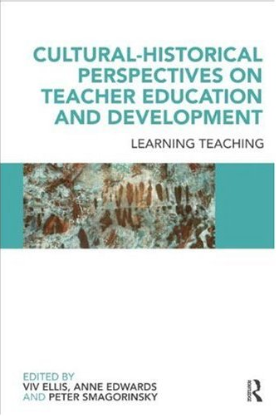
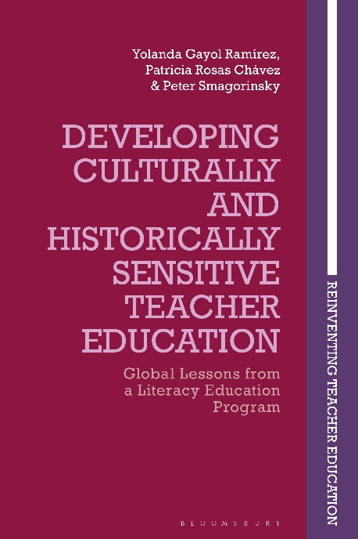
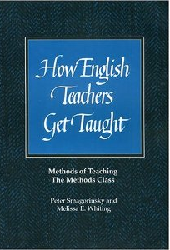
Teacher Education & Development Books

Slide 10
Teacher Education & Development Research Reports
Smagorinsky, P., & Jordahl, A. (1991). The student teacher/cooperating teacher collaborative study: A new source of knowledge. English Education, 23, 54-59.
Smagorinsky, P. (1996). Appropriating tools for teaching and research through collaborative independent study. English Education, 27, 127-142.
Smagorinsky, P. (1999). Time to teach. English Education, 32, 50-73.
Cook, L. S., Smagorinsky, P., Fry, P. G., Konopak, B., & Moore, C. (2002). Problems in developing a constructivist approach to teaching: One teacher's transition from teacher preparation to teaching. The Elementary School Journal, 102, 389-413.
Smagorinsky, P., Lakly, A., & Johnson, T. S. (2002). Acquiescence, accommodation, and resistance in learning to teach within a prescribed curriculum. English Education, 34, 187-213.
Johnson, T. S., Smagorinsky, P., Thompson, L., & Fry, P. G. (2003). Learning to teach the five-paragraph theme. Research in the Teaching of English, 38, 136-176.
Smagorinsky, P., Gibson, N., Moore, C., Bickmore, S., & Cook, L. S. (2004). Praxis shock: Making the transition from a student-centered university program to the corporate climate of schools. English Education, 36, 214-245.
Smagorinsky, P., Cook, L. S., Jackson, A. Y., Moore, C., & Fry, P. G. (2004). Tensions in learning to teach: Accommodation and the development of a teaching identity. Journal of Teacher Education, 55, 8-24.
Bickmore, S. T., Smagorinsky, P., & O’Donnell-Allen, C. (2005). Tensions between traditions: The role of contexts in learning to teach. English Education, 38, 23-52.
Smagorinsky, P., Sanford, A. D., & Konopak. B. (2006). Functional literacy in a constructivist key: A nontraditional student teacher’s apprenticeship in a rural elementary school. Teacher Education Quarterly, 33(4), 93-110.

Slide 11
Teacher Education & Development
Research Reports (Continued)
Smagorinsky, P., Wright, L., Augustine, S. M., O’Donnell-Allen, C., & Konopak, B. (2007). Student engagement in the teaching and learning of grammar: A case study of an early-career secondary school English teacher. Journal of Teacher Education, 58, 76-90.
Smagorinsky, P., Jakubiak, C., & Moore, C. (2008). Student teaching in the contact zone: Learning to teach amid multiple interests in a vocational English class. Journal of Teacher Education, 59, 442-454.
Smagorinsky, P., Wilson, A. A., & Moore, C. (2011). Teaching grammar and writing: A beginning teacher’s dilemma. English Education, 43, 263-293.
Smagorinsky, P., Rhym, D., & Moore, C. (2013). Competing centers of gravity: A beginning English teacher’s socialization process within conflictual settings. English Education, 45, 147-183.
Smagorinsky, P., & Barnes, M. E. (2014). Revisiting and revising the apprenticeship of observation. Teacher Education Quarterly, 41(4), 29-52.
Smagorinsky, P., Shelton, S. A., & Moore, C. (2015). The role of reflection in developing eupraxis in learning to teach English. Pedagogies: An International Journal, 10(4), 285-308.
Barnes, M. E., & Smagorinsky, P. (2016). What English/Language Arts teacher candidates learn during coursework and practica: A study of three teacher education programs. Journal of Teacher Education.
Smagorinsky, P., & Long, S.L. (2024). An eight-year longitudinal study of an English Language Arts teacher's developmental path through multiple contexts. Research in the Teaching of English, 59(1), 59(1), 51-85. http://dx.doi.org/10.58680/rte2024591147
Smagorinsky, P., & Long, S.L. (2025). Mediated memory of a mentor teacher. Culture and Education, 37(4),

Slide 12
Teacher Education Conceptual Papers
Smagorinsky, P. (1995). Teacher certification as personal and professional development. Voices from the Middle, 2(4), 21-26.
Grossman, P. L., Smagorinsky, P., & Valencia, S. (1999). Appropriating tools for teaching English: A theoretical framework for research on learning to teach. American Journal of Education, 108(1), 1-29.
Smagorinsky, P. (2001). Preservice secondary language arts teaching methods. In J. E. Many (Ed.), Handbook of instructional practices for literacy teacher-educators: Examples and reflections from the teaching lives of literacy scholars (pp. 91-97). Hillsdale, NJ: Erlbaum.
Smagorinsky, P., Cook, L. S., & Johnson, T. S. (2003). The twisting path of concept development in learning to teach. Teachers College Record, 105, 1399-1436.
Dickson, R., & Smagorinsky, P. (2006). Are methods enough? Situating teacher education programs within the multiple settings of learning to teach. English Education, 38, 312-328.
Smagorinsky, P., Augustine, S. M., & Gallas, K. (2006). Rethinking rhizomes in writing about research. The Teacher Educator, 42, 87-105.
Smagorinsky, P. (2010). A Vygotskian analysis of the construction of setting in learning to teach. In V. Ellis, A. Edwards, & P. Smagorinsky (Eds.), Cultural-historical perspectives on teacher education and development: Learning teaching (pp. 13-29). New York: Routledge.
Smagorinsky, P. (2010). The culture of learning to teach: The self-perpetuating cycle of conservative schooling. Teacher Education Quarterly, 37(2), 19-32.
Smagorinsky, P. (2013). The development of social and practical concepts in learning to teach: A synthesis and extension of Vygotsky's conception. Learning, Culture, and Social Interaction, 2(4), 238-248.

Slide 13
Teacher Education Conceptual Papers (Cont.)
Smagorinsky, P. (2014). Designing the task of teaching novice teachers how to design instructional tasks. In I. Thompson (Ed.), Designing tasks in secondary education: Enhancing subject understanding and student engagement (pp. 191-206) New York: Routledge.
Smagorinsky, P. (2018). Literacy in teacher education: “It’s the context, stupid.” Journal of Literacy Research, 50(3), 281–303.
Smagorinsky, P. (2020). Introduction. In Y. Gayol, P. Rosas, & P. Smagorinsky (Eds.), Developing culturally and historical sensitive teacher education: Global lessons from a literacy education program (pp. 1-28). London, UK: Bloomsbury.
Gayol, Y., & Smagorinsky, P. (2020). Conclusion: Networking Letras para Volar into the future. In Y. Gayol, P. Rosas, & P. Smagorinsky (Eds.), Developing culturally and historical sensitive teacher education: Global lessons from a literacy education program (pp. 307-314). London, UK: Bloomsbury.

Slide 14
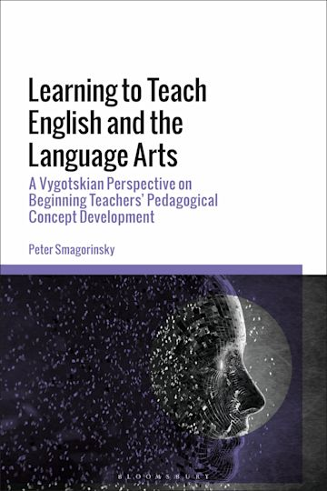
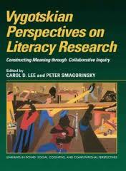
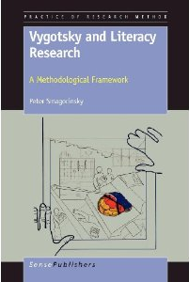
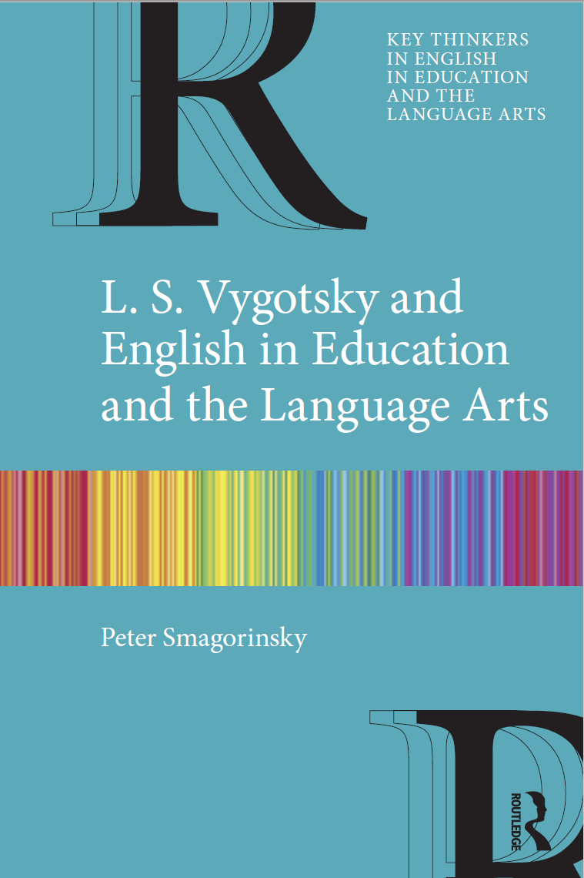
Books on Vygotsky

Slide 15
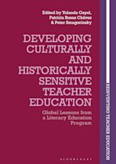
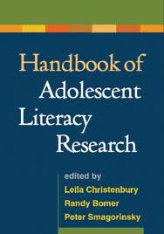
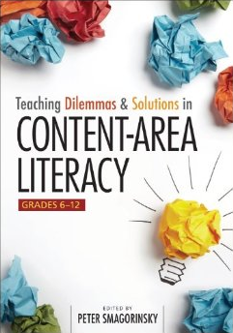
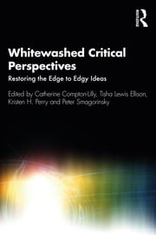
Research on Literacy, Broadly Speaking: Books

Slide 16
Research on Literacy, Broadly Speaking: Articles & Chapters
Smagorinsky, P., & Mayer, R. E. (2014). Learning to be literate. In K. Sawyer (Ed.), Cambridge handbook of the learning sciences (pp. 605-625). New York, NY: Cambridge University Press.
Smagorinsky, P. (2015). Disciplinary literacy in English/language arts. Journal of Adolescent & Adult Literacy, 59(2), 141-146.
Smagorinsky, P. (2015). Growth through Language Arts and the conundrum of teacher evaluation. Language Arts, 93(2), 108-112.
Smagorinsky, P. (2017). Discussion, conversation, and dialogue: Applebee, Bakhtin, and speech in school. In R. K. Durst, G. E. Newell, & J. D. Marshall (Eds.), English Language Arts research and teaching: Revisiting and extending Arthur Applebee’s contributions (pp. 27-40). New York, NY: Routledge.
Smagorinsky, P. (2017). Reconsidering Dartmouth from a social, institutional perspective. Language Arts Journal of Michigan, 33(1), 4-7.
Smagorinsky, P. (2018). Deconflating the ZPD and instructional scaffolding: Retranslating and reconceiving the zone of proximal development as the zone of next development. Learning, Culture and Social Interaction, 16, 70–75.
Smagorinsky, P. (2018). Is instructional scaffolding actually Vygotskian? And why should it matter to teachers? Journal of Adolescent & Adult Literacy, 62(3), 253-257.
Smagorinsky, P. (2018). Dartmouth’s growth model reconceived from a social perspective. In A. Goodwyn, C. Durrant, W. Sawyer, D. Zancanella, & L. Scherff (Eds.), The future of English teaching worldwide: Celebrating 50 years of the Dartmouth Conference (pp. 123-133). New York, NY: Routledge IFTE/NATE series in Educational Policy and Literacy.
Brooks, M. D., & Smagorinsky, P. (2020). Long-term English Learners. In H. Mohebbi & C. Coombe (Eds.), Research questions in language education: A reference guide for teachers (pp. 231-236). Amsterdam, NL: Springer.

Slide 17
Research on Literacy, Broadly Speaking: Articles & Chapters
Smagorinsky, P., Guay, M., Lewis Ellison, T., & Willis, A. I. (2020). A sociocultural perspective on readers, reading, reading instruction and assessment, reading policy, and reading research. In E. B. Moje, P. Afflerbach, P. Enciso, & N. K. Lesaux (Eds.), Handbook of reading research, Vol V (pp. 57-76). New York, NY: Routledge.
Smagorinsky, P. (2021). Third and hybrid spaces in literacy scholarship and practice: They are different, and their differences matter. In C. Compton-Lilly, T. Lewis Ellison, K. Perry, & P. Smagorinsky (Eds.), Whitewashed critical perspectives: Restoring the edge to edgy ideas in literacy education (pp. 18-40). New York, NY: Routledge.
Compton-Lilly, C., Lewis Ellison, T., Perry, K., & Smagorinsky, P. (2021). Introduction. In C. Compton-Lilly, T. Lewis Ellison, K. Perry, & P. Smagorinsky (Eds.), Whitewashed critical perspectives: Restoring the edge to edgy ideas in literacy education (pp. 1-17). New York, NY: Routledge.
Smagorinsky, P. (2021). Revising history to suit the present. Academia Letters, Article 279.
Smagorinsky, P., & Mayer, R. E. (2022). Learning to be literate. In K. Sawyer (Ed.), Cambridge handbook of the learning sciences, 3rd ed. (pp. 543-559). New York, NY: Cambridge University Press.
Smagorinsky, P. (2022). Un enfoque evolutivo, cultural y emocional de la alfabetización [A developmental, cultural, and emotional approach to literacy education]. In M. M. Vergara Fregoso, R. García Reynaga, & S. Ayala Ramírez (Eds.), Literacidad crítica, formación e inclusión [Literacy criticality, training and inclusion] (pp. 141-263). Guadalajara, MX: Editorial Universidad de Guadalajara, Centro Universitario de Arte, Arquitectura y Diseño, Instituto Transdisciplinar en Literacidad.
Smagorinsky, P. (2024). Cómo descolonicé mi propia percepción sobre la literacidad [How I decolonized my own thinking about literacy]. In P. Rosas & M. Moreno (Eds.), Exploraciones de los estudios en literacidad en el contexto latinoamericano [Explorations of literacy studies in the Latin American context] (pp. 61-71). Universidad de Guadalajara Publishing House.
Smagorinsky, P. (2024). Lantolf, Vygotsky, and learning through and about languages. Language Teaching Research Quarterly, 46, 7-24. https://doi.org/10.32038/ltrq.2024.46.02
Smagorinsky, P. (in press). Cultural-historical theory. In Encyclopedia of Cultural Psychology (L. Tateo, J. Valsiner, R. de Luca Picione, and S. Xu, Eds.). Edward Elgar Publishing.

Slide 18
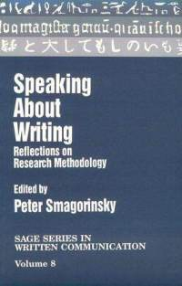
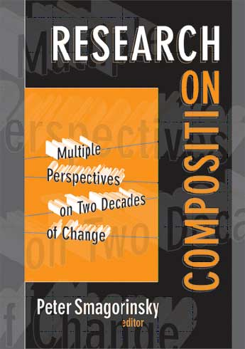
Writing Research: Books

Slide 19
Writing Research: Articles & ChaptERS
Smagorinsky, P. (1986). An apology for structured composition instruction. Written Communication, 3, 105-122.
Smagorinsky, P. (1991). The writer's knowledge and the writing process: A protocol analysis. Research in the Teaching of English, 25, 339-364.
Smagorinsky, P. (1992). How reading model essays affects writers. In J. W. Irwin & M. A. Doyle (Eds.), Reading/writing connections: Learning from research (pp. 160-176). Newark, DE: International Reading Association.
Smagorinsky, P. & Smith, M. W. (1992). The nature of knowledge in composition and literary understanding: The question of specificity. Review of Educational Research, 62, 279-305.
Smagorinsky, P. (1994). Models. In A. C. Purves (Ed.), Encyclopedia of English Studies and Language Arts (pp. 812-813). Urbana, IL: National Council of Teachers of English and Scholastic.
Smagorinsky, P. (1997). Personal growth in social context: A high school senior’s search for meaning in and through writing. Written Communication, 14, 63-105.
Smagorinsky, P. (2006). Overview. In P. Smagorinsky (Ed.), Research on composition: Multiple perspectives on two decades of change (pp. 1-14). New York: Teachers College Press.
Smagorinsky, P. (Editor) (2006). Writing in school contexts. Special themed issue of L1-Educational Studies of Language and Literature, 6(2).
Smagorinsky, P. (2010). Teaching writing in the age of accountability: Reflections from the academy. In G. A. Troia, R. K. Shankland, & A. Heintz (Eds.), Putting writing research into practice: Applications for teacher professional development (pp. 276-305). New York: Guilford.
Smagorinsky, P., Augustine, S. M., & O’Donnell-Allen, C. (2007). Experiences with personal, academic, and hybrid writing: A study of two high school seniors. English in Australia, 42(3), 55-73.
Smagorinsky, P., Daigle, E. A., O’Donnell-Allen, C., & Bynum, S. (2010). Bullshit in academic writing: A protocol analysis of a high school senior’s process of interpreting Much Ado About Nothing. Research in the Teaching of English, 44, 368-405.

Slide 20
Writing Research: Articles & ChaptERS
Smagorinsky, P., & Daigle, E. A. (2011). The role of affect in students’ writing for school. In E. Grigorenko, E. Mambrino, & D. Preiss (Eds.), Handbook of writing: A mosaic of perspectives and views (pp. 291-305). New York, NY: Psychology Press.
Jakubiak, C. & Smagorinsky, P. (2016). The discourse of voluntourism: An analysis of applications submitted to a summer overseas volunteer teaching program. The Journal of English as an International Language, 10(2), 108-137.
Smagorinsky, P. (2018). Emotion, reason, and argument: Teaching persuasive writing in tense times. English Journal, 107(5), 98-101.
Johnson, L.L., Chisam, J., Smagorinsky, P., & Wargo, K. (2018). Beyond publication: Social action as the ultimate stage of a writing process. Contribution to a special issue in honor of Gert Rijlaarsdam Making Connections: Studies of Language and Literature Education. L1-Educational Studies in Language and Literature, 18, 1-21.
Smagorinsky, P. (2022). Arguing controversies through civic discourse. Writing and Pedagogy, 14(3), 391–408.
Smagorinsky, P. (in press). The disputatious personality and the value of listening.
In K. B. Kelly, P. R. Rogers, & R. Vinz (Eds.), Building literate communities: In conversation with Sheridan Blau (pp. 161-184). National Council of Teachers of English.
Smagorinsky, P. (2025). Writing and reading qualitative characters. Written Communication, 42(3), . https://doi.org/10.1177/0741088325132831

Slide 21
Research on Nonverbal Composing
Funded by the Spencer Foundation , the Research Foundation of the National Council of Teachers of English,
and NCLB Title II Part A Higher Education IMPROVING TEACHER QUALITY Higher Education grant
Smagorinsky, P. (1992). Reconfiguring the English class through multiple intelligences. In J. Collins (Ed.), Vital signs 3: Restructuring the English class (pp. 35-44). Portsmouth, NH: Heinemann.
Smagorinsky, P., & Coppock, J. (1994). Cultural tools and the classroom context: An exploration of an alternative response to literature. Written Communication, 11, 283-310.
Smagorinsky, P., & Coppock, J. (1994). Exploring an evocation of the literary work: Processes and possibilities of an artistic response to literature. Reader, Fall, 62-74.
Smagorinsky, P., & Coppock, J. (1994). Exploring artistic response to literature. In C. K. Kinzer & D. J. Leu (Eds.), Multidimensional aspects of literacy research, theory, and practice (pp. 335-341). Forty-Third Yearbook of the National Reading Conference. Chicago: National Reading Conference.
Smagorinsky, P., & Coppock, J. (1995). Reading through the lines: An exploration of drama as a response to literature. Reading & Writing Quarterly, 11, 369-391.
Smagorinsky, P., & Coppock, J. (1995). The reader, the text, the context: An exploration of a choreographed response to literature. Journal of Reading Behavior, 27, 271-298.
  Translated into Portuguese as: Smagorinsky, P., & Coppock, J. (1999). Leitor, texto e contexto: Uma investigacao de resposta coreografica a literatura. Revista da Faeeba, 8(11), 101-124. (Ricardo Ottoni Vaz Japiassu, Trans.)
Smagorinsky, P. (1995). Constructing meaning in the disciplines: Reconceptualizing Writing Across the Curriculum as Composing Across the Curriculum. American Journal of Education, 103, 160-184.
Smagorinsky, P. (1997). Artistic composing as representational process. Journal of Applied Developmental Psychology, 18, 87-105.
Smagorinsky, P., & O’Donnell-Allen, C. (1998). Reading as mediated and mediating action: Composing meaning for literature through multimedia interpretive texts. Reading Research Quarterly, 33, 198-226.

Slide 22
Research on Nonverbal Composing (continued)
Smagorinsky, P., & O’Donnell-Allen, C. (1998). The depth and dynamics of context: Tracing the sources and channels of engagement and disengagement in students’ response to literature. Journal of Literacy Research, 30, 515-559.
Smagorinsky, P. (1999). The world is a stage: Dramatic enactment as response to literature. In B. J. Wagner (Ed.), Building moral communities through drama (pp. 19-38). Stamford, CT: Ablex.
O’Donnell-Allen, C., & Smagorinsky, P. (1999). Revising Ophelia: Rethinking questions of gender and power in school. English Journal, 88(3), 35-42.
Smagorinsky, P. (2000). What will be the influences of media on literacy in the new millennium? Reading Research Quarterly, 35(2), 277-278.
Smagorinsky, P., & O’Donnell-Allen, C. (2000). Idiocultural diversity in small groups: The role of the relational framework in collaborative learning. In C. D. Lee & P. Smagorinsky (Eds.), Vygotskian perspectives on literacy research: Constructing meaning through collaborative inquiry (pp. 165-190). New York: Cambridge University Press.
Smagorinsky, P. (2001). If meaning is constructed, what is it made from? Toward a cultural theory of reading. Review of Educational Research, 71, 133-169.
Smagorinsky, P., & O’Donnell-Allen, C. (2004). A study of students' artistic interpretations of Hamlet. In A. Goodwyn & A. Stables (Eds.), Language and literacy education (pp. 170-191). Thousand Oaks, CA: Sage.
Smagorinsky, P., Pettis, V., & Reed, P. (2004). High school students' compositions of ranch designs: Implications for academic and personal achievement. Written Communication, 21, 386-418.
Smagorinsky, P., Zoss, M., & O’Donnell-Allen, C. (2005). Mask-making as identity project in a high school English class: A case study. English in Education, 39(2), 58-73.
Smagorinsky, P., Cook, L. S., & Reed, P. (2005). The construction of meaning and identity in the composition and reading of an architectural text. Reading Research Quarterly, 40, 70-88.
Smagorinsky, P., Zoss, M., & Reed, P. (2006). Residential interior design as complex composition: A case study of a high school senior’s composing process. Written Communication, 23, 295-330.

Slide 23
Research on Nonverbal Composing (continued)
Zoss, M., Smagorinsky, P., & O’Donnell-Allen, C. (2007). Mask-making as representational process: The situated composition of an identity project in a senior English class. International Journal of Education & the Arts, 8(10).
Smagorinsky, P., Cameron, T., & O’Donnell-Allen, C. (2007). Achtung maybe: A case study of the role of personal connection and art in the literary engagement of students with attentional difficulties. Reading & Writing Quarterly, 23, 333–358.
Smagorinsky, P. (2009). The architecture of textuality: A semiotic view of composing in and out of school. In R. Beard, D. Myhill, M. Nystrand, & J. Riley (Eds.), Handbook of writing development (pp. 363-373). Thousand Oaks, CA: Sage.
Smagorinsky, P. (2010). The inscription of self in graphic texts in school. In M. C. Connery, V. John-Steiner, & A. Marjanovic-Shane (Eds.), Vygotsky and creativity: A cultural-historical approach to meaning-making, play, and the arts (pp. 125-140). New York: Peter Lang.
Martínez-Roldán, C. M., & Smagorinsky, P. (2011). Computer-mediated learning and young Latino/a students’ developing expertise. In P. Portes & S. Salas (Eds.), Vygotsky in 21st Century society: Advances in cultural historical theory and praxis with non-dominant communities (pp. 162-179). New York: Peter Lang.
Smagorinsky, P. (2011). Vygotsky’s stage theory: The psychology of art and the actor under the direction of perezhivanie. Mind, Culture, and Activity, 18, 319-341.
Smagorinsky, P., Anglin, J. L., & O’Donnell-Allen, C. (2012). Identity, meaning, and engagement with school: A Native American student’s composition of a life map in a senior English class. Journal of American Indian Education, 51(1), 22-44.
Johnson, L. L., & Smagorinsky, P. (2013). Writing remixed: Mapping the multimodal composition of one preservice English Education teacher. In K. Pytash & R. Ferdig (Eds.), Exploring multimodal composition and digital writing (pp. 262-280). Hershey, PA: IGI Global.

Slide 24
Research on Nonverbal Composing (continued)
Anglin, J. L., & Smagorinsky, P. (2014). Hip-hop Hamlet: Hybrid interpretive discourse in a suburban high school English class. Dialogic Pedagogy: An International Online Journal, 2, 41-69. DOI: 10.5195/dpj.2014.73.
Harman, R., & Smagorinsky, P. (2014). A critical performative process: Supporting the second language literacies and voices of emergent bilingual learners. Youth Theater Journal, 28, 1–18.

Slide 25
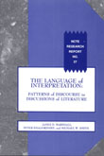
The Teaching and Learning of Literature
Marshall, J. D., Smagorinsky, P., & Smith, M. W. (1995). The language of interpretation: Patterns of discourse in discussions of literature. NCTE Research Report No. 27. Urbana, IL: National Council of Teachers of English.
Smagorinsky, P. (1990). Developing the social conscience through literature. In P. Phelan (Ed.) Literature and life: Making connections: Classroom practices in the teaching of English, Vol. 25 (pp. 13-18). Urbana, IL: National Council of Teachers of English.
Smagorinsky, P. (1992). Towards a civic education in a multicultural society: Ethical problems in teaching literature. English Education, 24, 212-228.
Smagorinsky, P. (1995). New canons, new problems: Promoting a sense of kinship among students of diversity. In B. A. Goebel & J. Hall (Eds.), Teaching a "new canon"?: Students, teachers, and texts in the college literature classroom (pp. 48-64). Urbana, IL: National Council of Teachers of English.
Burroughs, R. S., & Smagorinsky, P. (2009). The secondary English curriculum and adolescent literacy. In L. Christenbury, R. Bomer, & P. Smagorinsky (Eds.), Handbook of adolescent literacy research (pp. 170-182). New York: Guilford.

Slide 26
Social Processes in and out of Classrooms
Smagorinsky, P. (1993). Learning in the community in Oklahoma and beyond. Oklahoma English Journal, 7(2), 4-7.
Smagorinsky, P. & Fly, P. K. (1993). The social environment of the classroom: A Vygotskian perspective on small group process. Communication Education, 42, 159-171.
Davis, K., & Smagorinsky, P. (Editors). (1993). Language communities in the classroom. Special theme issue of the Oklahoma English Journal, 7(2). Ada, OK: Oklahoma Council of Teachers of English.
Gallas, K., & Smagorinsky, P. (2002). Approaching texts in school. The Reading Teacher, 56(1), 54-61.
Smagorinsky, P. (2002). Growth through English revisited. English Journal, 91(6), 23-29.
Smagorinsky, P. (2007). Vygotsky and the social dynamics of classrooms. English Journal, 97(2), 61-66.
Souto-Manning, M., & Smagorinsky, P. (2010). Freire, Vygotsky, and social justice theories in English education. In sj Miller & D. Kirkland (Eds.), Change matters: Critical essays on moving social justice research from theory to policy (pp. 41-51). New York: Peter Lang.
Portes, P., & Smagorinsky, P. (2010). Static structures, changing demographics: Educating for shifting populations in stable schools. English Education, 42, 236-248.
Kinloch, V., Nieto, S., & Smagorinsky, P. (2011). Conclusion: Reflections and insights on urban education. In V. Kinloch (Ed.), Urban literacies: Critical perspectives on language, learning, and community (pp. 195-200). New York: Teachers College Press.
Smagorinsky, P. (2011). A distant perspective on the School of the Dialogue of Cultures pedagogical movement in Ukraine and Russia. Journal of Russian and East European Psychology, 49(2), 29-35.
Smagorinsky, P. (2013). What does Vygotsky provide for the 21st century Language Arts teacher? Language Arts, 90, 190-202.
Smagorinsky, P. (2018). A Southern White man’s lessons on how to grow up racist. Journal of Language and Literacy Education, 14(1), 1-8

Slide 27
Social Processes in and out of Classrooms (Continued)
Noguerón-Liu, S., Hall, D., & Smagorinsky, P. (2017). Building on immigrant parents’ repertoires: Scaffolding online home-school communication in New Latin@ Diaspora contexts. In P. Portes & S. Salas (Eds.), Latinization and K-12 communities: National perspectives on regional change (pp. 3-21). Albany, NY: SUNY Press.
Heath, A. L., & Smagorinsky, P. (2018). Expeditionary learning, constructivism, and the hidden structures that impede their possibilities. In D. Kritt (Ed.), Constructivist education in an age of accountability (pp. 267-281). New York, NY: Palgrave Macmillan.
Smagorinsky, P. (2019). Emig Award recipient commentary. In Karen Morris with the 2019 Editorial Team, Fifty years of English Education: What the Emig Award-winning articles tell us. English Education, 51(4), 341-342.
Smagorinsky, P. (2021). The great equalizer of the conditions of [humanity]: How transformative can schools be when society itself remains inequitable and quarrelsome? In D. C. Berliner & C. Hermanns (Eds.), Public education: The cornerstone of American democracy (pp. 69-83). Teachers College Press. Smagorinsky, P. (2021). The relation between emotion and intellect: Which governs which? Integrative Psychological & Behavioral Science, 55, 769–778.
Smagorinsky, P. (2022). Vygotsky and multicultural education. In A. Garcia (Ed.), Multicultural education section; D. Fisher (Ed.), Routledge encyclopedia of education (online). New York, NY: Routledge.
Smagorinsky, P., & Lang, M. (2023). Learning to create environments for deafness among hearing preservice teachers: A defectological approach. Learning, Culture, and Social Interaction, 38.
Smagorinsky, P. (2024). Emotions, empathy, and education for social justice. English Teaching: Practice and Critique, 23(3), 332-351.

Slide 28
Research Methodology: Articles & Chapters
Smagorinsky, P. (1987). Graves revisited: A look at the methods and conclusions of the New Hampshire study. Written Communication, 4, 331-342.
Smagorinsky, P. (1989). The reliability and validity of protocol analysis. Written Communication, 6, 463-479.
Smagorinsky, P. (1994). Introduction: Potential problems and problematic potentials of using talk about writing as data about writing process. In P. Smagorinsky (Ed.), Speaking about writing: Reflections on research methodology (pp. ix-xix). Thousand Oaks, CA: Sage Publications.
Smagorinsky, P. (1994). Think-aloud protocol analysis: Beyond the black box. In P. Smagorinsky (Ed.), Speaking about writing: Reflections on research methodology (pp. 3-19). Thousand Oaks, CA: Sage Publications.
Smagorinsky, P. (1995). The social construction of data: Methodological problems of investigating learning in the zone of proximal development. Review of Educational Research, 65, 191-212.
Smagorinsky, P. (1998). Thinking and speech and protocol analysis. Mind, Culture, and Activity, 5, 157-177.
Smagorinsky, P. (2001). Rethinking protocol analysis from a cultural perspective. In M. McGroarty (Ed.), Annual Review of Applied Linguistics, 21 (pp. 233-245). New York: Cambridge University Press.
Smagorinsky, P., Augustine, S. M., & Gallas, K. (2006). Rethinking rhizomes in writing about research. The Teacher Educator, 42, 87-105.
Smagorinsky, P. (2008). The method section as conceptual epicenter in constructing social science research reports. Written Communication, 25, 389-411.

Slide 29
Research Methodology-Articles & Chapters (continued)
Smagorinsky, P. (2009). The cultural practice of reading and the standardized assessment of reading instruction: When incommensurate worlds collide. Educational Researcher, 38(7), pp. 522–527.
Smagorinsky, P. (2009). The culture of Vygotsky. Reading Research Quarterly, 44, 85-95.
Smagorinsky, P. (2011). Theory and method in research on literacy practices. In D. Lapp & D. Fisher (Eds.), Handbook of research on teaching the English language Arts, 3rd ed. (pp. 405-409). New York: Routledge, International Reading Association, & National Council of Teachers of English.
Shelton, S. A. & Smagorinsky, P. (2017). Conversation analysis, ethnomethodology, and teacher identity construction in interviews. In S. A. Mirhosseini (Ed.), Reflections on qualitative research in language and literacy education (pp. 121-135). New York, NY: Springer.
Smagorinsky, P. (2019). Warranting evidence in social science research reports. Research in the Teaching of English, 53(3), 273-275.
Yaden, D. B., Reinking, D. P., & Smagorinsky, P. (2021). The trouble with binaries: A perspective on a science of reading. Reading Research Quarterly, 56, 119-129,

Slide 30
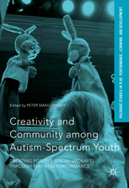
Mental Health
Smagorinsky, P. (Editor). (2016). Creativity and community among autism-spectrum youth: Creating positive social updrafts through play and performance. New York, NY: Palgrave Macmillan.
Includes the Following Chapters
Smagorinsky, P. (2016). Introduction. In P. Smagorinsky (Ed.), Creativity and community among autism-spectrum youth: Creating positive social updrafts through play and performance (pp. 3-31). New York, NY: Palgrave Macmillan.
Smagorinsky, P. (2016). Toward a social understanding of mental health. In P. Smagorinsky (Ed.), Creativity and community among autism-spectrum youth: Creating positive social updrafts through play and performance (pp. 33-49). New York, NY: Palgrave Macmillan.
Smagorinsky, P. (2016). Adaptation as reciprocal dynamic. In P. Smagorinsky (Ed.), Creativity and community among autism-spectrum youth: Creating positive social updrafts through play and performance (pp. 51-76). New York, NY: Palgrave Macmillan.
Lipkin, J., Epstein, M., Heller, P., & Smagorinsky, P. (2016). The DisAbility Project: A model for autism-specific creativity and civic engagement within the broader context of difference. In P. Smagorinsky (Ed.), Creativity and community among autism-spectrum youth: Creating positive social updrafts through play and performance (pp. 153-186). New York, NY: Palgrave Macmillan.
Cook, L. S., & Smagorinsky, P. (2016). The anime culture as positive social updraft. In P. Smagorinsky (Ed.), Creativity and community among autism-spectrum youth: Creating positive social updrafts through play and performance (pp. 219-242). New York, NY: Palgrave Macmillan.
Smagorinsky, P. (2016). An autistic life, animated through the world of Disney. In P. Smagorinsky (Ed.), Creativity and community among autism-spectrum youth: Creating positive social updrafts through play and performance (pp. 269-291). New York, NY: Palgrave Macmillan.

Slide 31
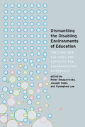
Mental Health
Smagorinsky, P., Tobin, J., & Lee, K. (Editors) (2019). Dismantling the disabling environments of education: Creating new cultures and contexts for accommodating difference. New York, NY: Peter Lang.
Includes the Following Chapters
Smagorinsky, P. (2019). Vygotsky, “defectology,” and the Soviet approach to human difference. In P. Smagorinsky, J. Tobin, & K. Lee (Eds.), Dismantling the disabling environments of education: Creating new cultures and contexts for accommodating difference (pp. 47-64). New York, NY: Peter Lang.
Smagorinsky, P., Tobin, J., & Lee, K. (2019). Introduction. In P. Smagorinsky, J. Tobin, & K. Lee (Eds.),. New York, NY: Peter Lang. Dismantling the disabling environments of education: Creating new cultures and contexts for accommodating difference (pp. 1-22). New York, NY: Peter Lang.

Slide 32
Mental Health
Smagorinsky, P. (2011). Confessions of a mad professor: An autoethnographic consideration of neuroatypicality, extranormativity, and education. Teachers College Record, 113, 1701-1732.
Smagorinsky, P. (2012). Vygotsky, “defectology," and the inclusion of people of difference in the broader cultural stream. Journal of Language and Literacy Education [Online], 8(1), 1-25.
Smagorinsky, P. (2012). “Every individual has his own insanity”: Applying Vygotsky’s work on defectology to the question of mental health as an issue of inclusion. Learning, Culture and Social Interaction, 1(1), 67-77.
Smagorinsky, P. (2014). Who's normal here? An atypical's perspective on mental health and educational inclusion. English Journal, 103(5), 15–23.
Cook, L. S., & Smagorinsky, P. (2014). Constructing positive social updrafts for extranormative personalities. Learning, Culture and Social Interaction, 3(4), 296–308.
Smagorinsky, P. (2014, November 26). Taking the diss out of disability. Teachers College Record.
Smagorinsky, P., Cole, M., & Braga, L. W. (2017). On the complementarity of cultural historical psychology and contemporary disability studies. In I. Esmonde & A. Booker (Eds.), Power and privilege in the learning sciences: Critical and sociocultural theories (pp. 70-92). New York, NY: Routledge.
Smagorinsky, P. (2018). Inclusion, “defectology,” and second language learners. In J. Lantolf & M. Poehner, Handbook of sociocultural theory and second language development (pp. 551-564). New York, NY: Routledge.
Smagorinsky, P. (2019). Vygotsky, “defectology,” and the Soviet approach to human difference. In P. Smagorinsky, J. Tobin, & K. Lee (Eds.), Dismantling the disabling environments of education: Creating new cultures and contexts for accommodating difference (pp. 47-64). New York, NY: Peter Lang.

Slide 33
Mental Heath
Smagorinsky, P. (2020). Neurodiversity and the deep structure of schools. Ought.
Smagorinsky, P. (in press). Defectology: The stone rejected by the builder becomes the cornerstone of a new construct. In J.A Hilppö, J. Melendez, M. Lynch, M. Lemos, P. Martínez-Álvarez, & P. Hick (Eds.), Handbook of cultural historical research: Overcoming injustices through education and learning. Bloomsbury.

Slide 34
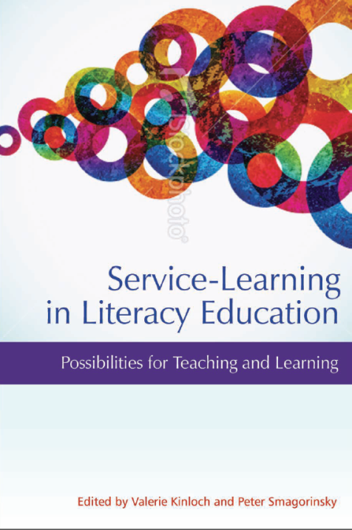
Service-Learning
Smagorinsky, P. (2014). Service-learning in an alternative school as mediated through book club discussions. In V. Kinloch & P. Smagorinsky (Eds.), Service-learning in literacy education: Possibilities for teaching and learning (pp. 85-103). Charlotte, NC: Information Age Publishing.
Smagorinsky, P., & Kinloch, V. (2014). Introduction. In V. Kinloch & P. Smagorinsky (Eds.), Service-learning in literacy education: Possibilities for teaching and learning (pp. ix-xxiii). Charlotte, NC: Information Age Publishing.

Slide 35
Service-Learning (Continued)
Articles and Chapters
Smagorinsky, P. (2011). Service-learning as a vehicle for examining assumptions about culture and education. In A. Honigsfeld & A. Cohan (Eds.), Breaking the mold of school instruction and organization: Preservice and inservice teacher education (pp. 65-74). Lanham, MD: Rowman and Littlefield.
Smagorinsky, P., Clayton, C. M., & Johnson, L. L. (2015). Distributed scaffolding in a service-learning course. Theory into Practice, 54(1), 71-78.
Smagorinsky, P., Johnson, L. L. & Clayton, C. M. (2015). Synthesizing formal and experiential concepts in a service-learning course. In J. Brass & A. Webb (Eds.), Reclaiming English Language Arts methods courses: Critical issues and challenges for teacher educators in top-down times (pp. 123-134). New York: Routledge.
Smagorinsky, P., with Brasley, A., Johnson, R., & Shurtz, L. (2017). A letter to teacher candidates at the dawn of the Trump presidency. English Teaching: Practice and Critique, 16(3), 319-330.
Smagorinsky, P. (2019). Inquiry and service-learning in teacher education. In E. A. Kahn, A. Bouque, D. Forde, T. M. McCann, & C. C. Walter (Eds.), Inquiry paths to literacy learning (pp. 119-136). Lanham, MD: Rowman & Littlefield.
Smagorinsky, P., & Johnson, L. L. (2021). Empathic framing during concept development in book club discussions in a service-learning teacher education class. Language and Sociocultural Theory, 8(2), 206–238. https://doi.org/10.1558/lst.18853.
Smagorinsky, P., & Lang, M. (2023). Learning to create environments for deafness among hearing preservice teachers: A defectological approach. Learning, Culture, and Social Interaction, 38.

Slide 36
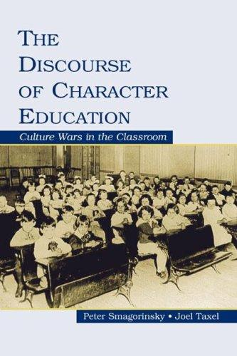
Character Education
Smagorinsky, P. (2000). Reflecting on character education through literary themes. English Journal, 89(5), 64-69.
Smagorinsky, P., & Taxel, J. (2004). The discourse of character education: Ideology and politics in the proposal and award of federal grants. Journal of Research in Character Education, 2(2), 113–140.
Smagorinsky, P., Boggs, G. L., Jakubiak, C. A., & Wilson, A. A. (2010). The implied character curriculum in vocational and nonvocational English classes: Designing social futures for working class students and their teachers. Journal of Research in Character Education, 8(2), 1-23.
Smagorinsky, P. (2018). Character education. In J. I. Liontas, (Ed.), The TESOL encyclopedia of English language teaching, first edition , organizational and administrative issues. [M. DelliCarpini (Project Ed.); Salas, S. (Volume Ed]. Boston, MA: Wiley-Blackwell. DOI: 10.1002/9781118784235.
Smagorinsky, P. (2021, February 6). The ideological character of character education. Chicago, IL: The University of Chicago Center for Practical Wisdom.

Slide 37
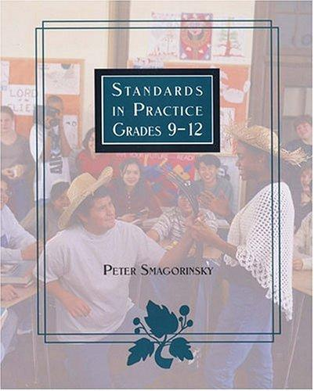
Policy and Standards Publications
Smagorinsky, P. (1999). Standards revisited: The importance of being there. English Journal, 88(4), 82-88.
Freedman, S., Miller, S., Smagorinsky, P., Stallworth, J., & Zancanella, D. (2011). An analysis of the NCTQ/U.S. News & World Report plan to evaluate and rank teacher education programs in colleges and universities.
Smagorinsky, P. (2014). Authentic teacher evaluation: A two-tiered proposal for formative and summative assessment. English Education, 46(2), 165-185.
Smagorinsky, P. (2015). Speaking out in the public sphere: Why, what, where, and how teachers can enter the fray. English Journal, 104(3), 91–96.
Smagorinsky, P. (2017). Misfits in school literacy: Whom are U. S. schools designed to serve? In D. Appleman & K. Hinchman (Eds.), Adolescent literacy: A handbook of practice-based research (pp. 199-214). New York, NY: Guilford.
Smagorinsky, P. (2020). The essential role of relationships and emotional life in schooling. School Administrator, October, 36-39.
Smagorinsky, P. (2022). The creation of national cultures through education, the inequities they produce, and the challenges for multicultural education. International Journal of Multicultural Education, 24(2), 80-96.

Slide 38
Autobiographical Pieces
Smagorinsky, P. (1998). I did it my way . . . . with a little help from my friends. In R. Larson & T. McCracken, with J. Entes (Eds.), Teaching college English and English education: Reflective stories (pp. 82-88). Urbana, IL: Conference on English Education and National Council of Teachers of English.
Smagorinsky, P. (2011). NCTE & me: Reflections on the Council's role in one teacher's life. English Journal, 101(1), 111-116.
Smagorinsky, P. (2022). An intellectual path paved with emotions and shaped by cultures. In D. Sumara & D. Alvermann (Eds.), Ideas that changed literacy practices: First person accounts from leading voices (pp. 287-296). Gorham, ME: Myers Education Press.
Smagorinsky, P. (2023). My life as a gardener. In J. Avila (Ed.), Leaders in English Language Arts education: Intellectual self portraits (pp. 216-230). Brill.
Biographical Pieces
Bracewell, R., Brandt, D., Chin, E., Daly, J., Flower, L., Freedman, S. W., Gutierrez, K., Hull, G., Rose, M., & Smagorinsky, P. (2004). Tributes to Stephen P. Witte. Research in the Teaching of English, 39, 7-19.
Smagorinsky, P. (2013). The bold and courageous path of Vera John-Steiner. In R. Lake & C. Connery (Eds.), Constructing a community of thought: Letters on the scholarship, teaching and mentoring of Vera John-Steiner (pp. 13-16). New York: Peter Lang.
Smagorinsky, P. (Ed.). (2015). Anagastopoulos, D., Lee, C. D., Smagorinsky, P., & Smith, M. W., A Tribute to George Hillocks, Jr. Research in the Teaching of English, 50, 236-248.

Slide 39
Book Forewords
Smagorinsky, P. (2022). Foreword. In M. Shoffner & A. W. Webb (Eds.), Reconstructing care in teacher education after COVID-19: Caring enough to change (pp. xviii-xxi). Routledge.
Smagorinsky, P. (in press). Foreword. In T. M. McCann, E. A. Kahn, S. Hochstetler, & D. Chambers, On the case in the English Language Arts classroom: Situations for the teaching of English. Urbana, IL: National Council of Teachers of English.
Smagorinsky, P. (2021). Foreword. In N. Sieben & S. A. Shelton (Eds.), Humanizing grief in higher education: Narratives of allyship and hope (pp. xx-xxiv). New York, NY: Routledge.
Smagorinsky, P. (2020). Foreword. In D. Forde, A. Bouque, E. A. Kahn, T. M. McCann, & C C. Walter (Eds.), Inquiry units for English Language Arts (pp. vii-xii). Landham, MD: Rowman and Littlefield.
Smagorinsky, P. (2020). Foreword. In E. Chase, N. P. Morabito, & S. S. Abrams, Writing in education: The art of writing for educators (pp. xi-xiv). Boston, MA: Brill/Sense.
Smagorinsky, P. (2019). Foreword. In C. I. Mercado, Navigating teacher education in complex an uncertain times: Re-imagining teacher education a borderless world (pp. viii-xiii). London, UK: Bloomsbury.
Smagorinsky, P. (2018). Foreword. In S. Hochstetler (Ed.), Reform and literacy education: History, effects, and advocacy (pp. ix-xiii). New York, NY: Routledge.
Smagorinsky, P. (2017). Foreword. In D. Pasternak, S. Caughlan, H. Hallman, L. A. Renzi, & L. Rush, Secondary English teacher education in the United States (pp. viii-xii). London, UK: Bloomsbury.
Smagorinsky, P. (2016). Foreword: English education. In A. Brown & L. Rodesiler (Eds.), Developing contemporary literacies through sports: A guide for the English classroom (pp. xi-xii). Urbana, IL: National Council of Teachers of English.

Slide 40
Book Forewords (Continued)
Smagorinsky, P. (2015). Foreword. In D. Reed & T. Hicks, Research writing rewired: Lessons that ground students’ digital learning (pp. xiv–xv). Thousand Oaks, CA: Corwin.
Smagorinsky, P. (2015). Foreword. In T. M. McCann, R. D’Angelo, N. Galas, & M. Greska, Literacy and history in action: Immersive approaches to disciplinary thinking, grades 5-12 (pp. ix-xii). New York, NY: Teachers College Press.
Smagorinsky, P. (2007). Foreword. In V. Ellis, Subject knowledge and teacher education: The development of beginning teachers' thinking (pp. xi-xii). London & New York: Continuum.
Smagorinsky, P. (2006). Foreword. In C. O’Donnell-Allen, The book club companion: Fostering strategic readers in the secondary classroom (pp. viii-xiv). Portsmouth, NH: Heinemann.
Smagorinsky, P. (2002). Foreword. In L. R. Johannessen & T. M. McCann, In case you teach English: An interactive casebook for prospective and practicing teachers (pp. ix-xi). Upper Saddle River, NJ: Merrill/Prentice-Hall.

Slide 41
Public Essays
Smagorinsky, P. (2010, May 31). Teachers can’t be judged by tests. Atlanta Journal-Constitution.
Smagorinsky, P. (2010, June 8). Make every school a charter school. Atlanta Journal-Constitution.
Smagorinsky, P. (2011, January 10). Want reform? Why not ask teachers for ideas? Atlanta Journal-Constitution.
Smagorinsky, P. (2011, February 7). Putting Socrates and Jesus to the good-teacher test. Atlanta Journal-Constitution.
Smagorinsky, P. (2011, June 20). Does class size matter? Don’t ask Bill Gates. Ask a teacher. Atlanta Journal-Constitution.
Smagorinsky, P. (2011, June 29). Great principals hire great teachers and get out of their way. Atlanta Journal-Constitution.
Smagorinsky, P. (2011). Viewpoint: School’s out----of touch with teachers. UGA Research Magazine, Fall, 32-33.
Smagorinsky, P. (2011, September 19). The latest in free-market educational solutions. The Answer Sheet of The Washington Post.
Smagorinsky, P. (2011, November 8). Efforts to “quantify teaching have become a national obsession on its way to becoming a national joke.” Atlanta Journal-Constitution. Smagorinsky, P. (2012, March 5). If you kill the heart and soul of a school, what’s left? Atlanta Journal-Constitution.
Smagorinsky, P. (2012, March 11). Why the Ed Department should be reconceived—or abolished. The Answer Sheet of The Washington Post.
Smagorinsky, P. (2012, March 28). How to remake the Education Department (or, it’s time to give teachers a chance). The Answer Sheet of The Washington Post.

Slide 42
Public Essays (Continued)
Smagorinsky, P. (2012, April 1). The billion dollar question for Arne Duncan: Why has testing become the driver in school reform? Atlanta Journal-Constitution.
Smagorinsky, P. (2012, April 3). How do you know when teaching is good?
Smagorinsky, P. (2012, May 26). Is there a teacher in this room? Why don’t we ever recognize the great teachers behind the great students? Atlanta Journal-Constitution.
Smagorinsky, P. (2012, June 13). The real educational crisis is manufactured educational crises. Atlanta Journal-Constitution.
Smagorinsky, P. (2012, June 30). Testing mandates flunk cost-benefit analysis. The Answer Sheet of The Washington Post.
Smagorinsky, P. (2012, July 14). Great Georgia teachers: Beyond the test scores. Atlanta Journal-Constitution.
Smagorinsky, P. (2012, September 7). What do we care about when we care about education? The Athens Patch.
Smagorinsky, P. (2012, September 10). When a teacher teaches in a lonely forest. Atlanta Journal-Constitution.
Smagorinsky, P. (2012, September 27). Another great Georgia teacher: Angela Dean of Gwinnett. Atlanta Journal-Constitution.
Smagorinsky, P. (2012, October 25). Another great Georgia teacher: Justin Sealy of Pelham City Schools. Atlanta Journal-Constitution.
Smagorinsky, P. (2012, November 27). A teacher led by faith and fire for her students: Bettina Polite Tate of Savannah’s Johnson High. Atlanta Journal-Constitution.
Walker, M., & Smagorinsky, P. (2013, January 1). The power of school music programs: Students come for the music and stay for the math. Atlanta Journal-Constitution.
Smagorinsky, P. (2013, January 21). My View: Hear the music - STEM studies aren't the only path to a better future. CNN Schools of Thought.
Smagorinsky, P. (2013, January 24). Great teachers: Effingham County’s Mark Weese teaches the wonders of science. Atlanta Journal-Constitution.

Slide 43
Public Essays (Continued)
Smagorinsky, P. (2013, February 13). Why is the image of public education distorted by media? Atlanta Journal-Constitution.
Smagorinsky, P. (2013, March 18). Griffin-Spalding teacher Lisa Miller: Coming home to teach. Atlanta Journal-Constitution.
Smagorinsky, P. (2013, April 3). Seeing teachers as technicians ignores what else they give students: Confidence, moral support and inspiration. Atlanta Journal-Constitution.
Smagorinsky, P. (2013, May 7). An ominous warning about the state of American education. DevEd: Developing Education.
Smagorinsky, P. (2013, May 27). Is teaching a special career, or a job like any other? Atlanta Journal-Constitution.
Smagorinsky, P. (2013, June 13). The Snark syndrome in educational policymaking. Atlanta Journal-Constitution.
Smagorinsky, P. (2013, July 8). Common Core State Standards: A lesson in shrewd marketing. Atlanta Journal-Constitution.
Smagorinsky, P. (2013, August 9). Great teacher series: The energy and creativity of Grady High School's Dave Winter. Atlanta Journal-Constitution.
Smagorinsky, P. (2013, September 16). Carpe diem in the public sphere. Part I. Teachers, Profs, Parents: Writers Who Care.
Smagorinsky, P. (2013, September 19). Carpe diem in the public sphere. Part II. Teachers, Profs, Parents: Writers Who Care.
Davis, E., Johnson, L. L., & Smagorinsky, P. (2013, October 8). A great group of great teachers in Morgan County. Monroe Patch.
Smagorinsky, P. (2013, November 14). What can be measured can be managed. Does it apply to education and can it be managed well? Atlanta Journal-Constitution.
Smagorinsky, P. (2014, January 10). Why the arts and arts teachers enrich schools. Atlanta Journal-Constitution.
Thorne, M., & Smagorinsky, P. (2014, January 18). The unseen benefits of the arts in schools. Rockdale News.

Slide 44
Public Essays (Continued)
Smagorinsky, P. (2014, January 19). Students need soft skills, hard facts. Atlanta Journal-Constitution.
Smagorinsky, P. (2014, January 25). Why our kids need drama. Psychology Today. Available at Smagorinsky, P. (2014, February 11). New era of accountability: Reducing students to "anonymous data points." Atlanta Journal-Constitution.
Smagorinsky, P. (2014, March 14). More A’s in English classes? Not easier material or grade inflation but more open-ended discussion. Atlanta Journal-Constitution.
Smagorinsky, P. (2014, April 7). Great Georgia Teachers: Atlanta's Elisha Gray. 'I see abilities, not disabilities.' Atlanta Journal-Constitution.
Smagorinsky, P. (2014, May 8). Great Georgia Teachers: Stephanie Fuerte of Muscogee offers tough love, ground rules and great results. Atlanta Journal-Constitution.
Smagorinsky, P. (2014, June 3). School to work: Is it working? Atlanta Journal-Constitution.
Smagorinsky, P. (2014, June 9). The cost of college: A burden worth sharing? Atlanta Journal-Constitution.
Smagorinsky, P. (2014, June 17). Response to the new NCTQ Teacher Prep Review.
Arnold, J., & Smagorinsky, P. (2014, June 24). Better ways to use millions of dollars now spent on testing. The Answer Sheet of The Washington Post.
Smagorinsky, P. (2014, July 17). Viewing every black student as at-risk: Are we pathologizing children rather than helping them? Atlanta Journal-Constitution.
Smagorinsky, P. (2014, July 19). The ideal head: Bizarre racial teachings from a 1906 textbook. The Atlantic.
Smagorinsky, P. (2014, July 21). Educating the public on the public’s terms: An open letter to academics. Teachers, Profs, Parents: Writers Who Care.
Smagorinsky, P. (2014, July 28). Bad student writers: You get what you pay for. Atlanta Journal-Constitution.
Smagorinsky, P. (2014, August 13). Atlanta cheating scandal: A tragedy of teaching and learning. Atlanta Journal-Constitution.

Slide 45
Public Essays (Continued)
Arnold, J., & Smagorinsky, P. (2014, August 20). Georgia: Time to reform the reformers. Smagorinsky, P. (2014, August 31). Education myth busters: Do criticisms of U.S. schools rely on bad information and distortions? Atlanta Journal-Constitution.
Smagorinsky, P. (2014, October 6). Georgia will judge teachers on student growth. But growth toward what end? Atlanta Journal-Constitution.
Smagorinsky, P. (2014, October 28). Baseball and teaching: Why simplistic measures of performance strike out in both professions. Atlanta Journal-Constitution.
Smagorinsky, P. (2014, November 30). Another Great Georgia Teacher: Her classroom hums with activity. Atlanta Journal-Constitution.
Smagorinsky, P. (2015, January 20). Great Georgia teacher Becky Cross: A reflection of great commitment and great influences. Atlanta Journal-Constitution.
Smagorinsky, P. (2015, February 9). Issue isn’t welding vs. Chaucer. It’s how to remove barriers to college. Atlanta Journal-Constitution.
Smagorinsky, P. (2015, February 25). Community college: Not ‘failing diploma mills,’ but pathways to success. Atlanta Journal-Constitution.
Smagorinsky, P. (2015, April 23). A teacher who understands third graders need play, joy and calm to learn. Atlanta Journal-Constitution.
Smagorinsky, P. (2015, May 30). Should schools follow competitive or cooperative models? Can they be both? Atlanta Journal-Constitution.
Smagorinsky, P. (2015, July 1). Testing and technology in Georgia schools: Who will watch the watchers? Atlanta Journal-Constitution.
Smagorinsky, P. (2015, July 21). To be or not to be politically correct: What was that question? Atlanta Journal-Constitution.
Smagorinsky, P. (2015, September). Political correctness and the future of society. Scholars Speak Out of the Journal of Language and Literacy Education.
Smagorinsky, P. (2015, December 4). More than three decades later, student recalls teacher’s kindness. Atlanta Journal-Constitution.

Slide 46
Public Essays (Continued)
Smagorinsky, P. (2016, January 19). Can we produce innovative students with teachers chained to a script? Atlanta Journal-Constitution.
Smagorinsky, P. (2016, March 2). The fictions of teaching from ‘Dangerous Minds’ to ‘Downton Abbey.’ Atlanta Journal-Constitution
Smagorinsky, P. (2016, March 27). UGA professor: Violence at Trump rallies shows dangers of ‘good guys’ with guns on campus. Atlanta Journal-Constitution.
Smagorinsky, P. (2016, May 22). Controversy over transgender students: Why can’t schools designate a unisex restroom? Atlanta Journal-Constitution.
Smagorinsky, P. (2016, May 28). University of Georgia professor explains his ‘Asperger’s Advantage’ and disabling assumption of disorder. Atlanta Journal-Constitution.
Smagorinsky, P. (2016, June 30). Schools ought to produce good citizens as well as good students. Atlanta Journal-Constitution.
Smagorinsky, P. (2016, July 9). Is mental health strictly mental? Psychology Today.
Smagorinsky, P. (2016, August 2016). Foregrounding potential, not disorder, in neurodiverse students. Literacy & NCTE.
Smagorinsky, P. (2016, October 5). A brief guide to neurodiversity. The Committed Project.
Smagorinsky, P. (2016, November 14). Great Georgia teachers: Lauren Eckman brings out potential in visually impaired students. Atlanta Journal-Constitution.
Smagorinsky, P. (2016, November 29). Common Core turns students into literary critics. Does it turn them into lifelong readers? Atlanta Journal-Constitution.
Smagorinsky, P. (2017, January 24). Defeated by too many students and scripted instruction, a good teacher becomes an ex-teacher. Atlanta Journal-Constitution.
Smagorinsky, P. (2017, February 28). Before you can get kids to care about school, you have to show you care about them. Atlanta Journal-Constitution.
Smagorinsky, P. (2017, May 29). Boy objects to female president. Are schools supposed to fix that? Atlanta Journal-Constitution.
Smagorinsky, P. (2017, August 21). Reason, emotion, thinking, and writing in school. Teachers, Profs, Parents: Writers Who Care.

Slide 47
Public Essays (Continued)
Smagorinsky, P. (2017, August 30). Great Georgia teachers: Brookwood High’s Carrie Settles Livers makes science real, relevant. Atlanta Journal-Constitution.
Smagorinsky, P. (2017, October 3). A UGA professor of education asks: Why is school so boring? Atlanta Journal-Constitution.
Smagorinsky, P. (2017, December 26). How do we define and measure whether a student is literate? Atlanta Journal-Constitution.
Smagorinsky, P. (2018, January 1). What if schools focused on improving relationships rather than test scores? Atlanta Journal-Constitution.
Smagorinsky, P. (2018, February 14). When schools mine data to death, teacher spirit also dies. Atlanta Journal-Constitution.
Smagorinsky, P. (2018, April 2). Opinion: Principal sets tone that turns a school into a community. Atlanta Journal-Constitution
Smagorinsky, P. (2018, May 24). How to evaluate whether a school works? Ask the students. Atlanta Journal-Constitution.
Smagorinsky, P. (2018, June 3). Parkland school shooting provoked fears that won’t go away. Atlanta Journal-Constitution.
Smagorinsky, P. (June 26, 2008). Whose cultural values should schools promote? Who decides? Atlanta Journal-Constitution.
Smagorinsky, P. (July 23). How do schools balance a policing culture with a learning one? Atlanta Journal-Constitution.
Smagorinsky, P. (2018, August 12). Opinion: We can’t retool U.S. schools based on Finland or China. Atlanta Journal-Constitution.
Smagorinsky, P. (2018, August 30). When friends don’t let friends become teachers. Atlanta Journal-Constitution.
Smagorinsky, P. (2018, September 6). Even if teachers give 110 percent, can 100 percent of kids succeed? Atlanta Journal-Constitution.

Slide 48
Public Essays (Continued)
Smagorinsky, P. (2019, January 28). Cultivating relationships has always been the heart of schooling. Atlanta Journal-Constitution.
Smagorinsky, P. (2019, February 26). The ‘why’ of history is more compelling than the ‘when.’ Atlanta Journal-Constitution.
Smagorinsky, P. (2019, March 22). Opinion: Easier to blame teachers for achievement gap than tackle poverty. Atlanta Journal-Constitution.
Smagorinsky, P. (2019, April 1). Does Trump’s order clarify or complicate free speech on campus? Atlanta Journal-Constitution.
Smagorinsky, P. (2019, June 12). #EvaluateThis: Athens teacher breaks barriers, builds relationships. Atlanta Journal-Constitution.
Smagorinsky, P. (2019, July 5). Opinion: Improving teacher education won’t matter if teaching conditions worsen. Atlanta Journal-Constitution.
Smagorinsky, P. (2019, July 23). Danger of turning classroom lectern into social justice pulpit. Atlanta Journal-Constitution.
Smagorinsky, P. (2019, August 23). When kids refuse to read and nothing will persuade them. Atlanta Journal-Constitution.
Long, S. L., & Smagorinsky, P. (2019, September 12). Is anyone considering the social and emotional needs of teachers? Atlanta Journal-Constitution.
Smagorinsky, P. (2019, October 3). Building schools as bunkers, not as sanctuaries for learning. Atlanta Journal-Constitution.
Smagorinsky, P. (2019, November 14). Opinion: Maybe, it’s time to say nope to NAEP. Atlanta Journal-Constitution.
Smagorinsky, P. (2020, January 30). Opinion: From nuclear attacks to active shooters, fear continues. Atlanta Journal-Constitution.
Smagorinsky, P. (2020, April 8). Opinion: We can’t expect every kid to shift to online learning without skipping a beat. Atlanta Journal-Constitution.
Smagorinsky, P. (2020, May 21). Opinion: Pay more attention to mental health than to test scores. Atlanta Journal-Constitution.

Slide 49
Public Essays (Continued)
Smagorinsky, P. (2020, July 9). Education in a time of upheaval: What can we learn? K-12 Talk of W. W. Norton.
Smagorinsky, P. (2020, August 26). Remembering a great Georgia teacher lost to COVID-19. Atlanta Journal-Constitution.
Smagorinsky, P. (2021, January 18). OPINION: From their safe havens, leaders order teachers into classrooms. Atlanta Journal-Constitution.
Smagorinsky, P. (2021, February 3). OPINION: Strengthening teacher pipeline won’t matter if destination is a sewer. Atlanta Journal-Constitution.
Smagorinsky, P. (2021, February 21). OPINION: Every curriculum is ideological. Atlanta Journal-Constitution.
Smagorinsky, P. (2021, May 18). Opinion: Classrooms play defense while football scores. Atlanta Journal-Constitution.
Smagorinsky, P. (2021, October 5). Opinion: Who would want to be a teacher these days? Atlanta Journal-Constitution.
Smagorinsky, P. (2021, October 27). Opinion: Georgia’s tenure review process is arduous, thorough and working. Atlanta Journal-Constitution.
Smagorinsky, P. (2021, November 23). Opinion: When teachers face a bounty for lessons about race. Atlanta Journal-Constitution.
Smagorinsky, P. (2022, March 10). Opinion: Georgia schools are so white they alienate students of color. Atlanta Journal-Constitution.
Reinking, D., Smagorinsky, P., & Yaden, D. (2022, May 26). Opinion: Phonics is not a panacea for all struggling readers. Atlanta Journal-Constitution.
Skerrett, A., & Smagorinsky, P. (2022, August 16). Teaching in tough times: Addressing a different sort of learning loss. Corwin Connect.
Smagorinsky, P. (2022, September 1). Opinion: Teachers tired of fighting cellphones in classrooms. Atlanta Journal-Constitution.
Smagorinsky, P. (2022, November 30). Opinion: Starting small might aid Gwinnett’s school discipline shift. Atlanta Journal-Constitution.

Slide 50
Public Essays (Continued)
Smagorinsky, P. (2023, January 12). Opinion: Higher expectations for teachers, schools yet same low funding. Atlanta Journal-Constitution.
Smagorinsky, P. (2023, March 9). Opinion: Is it fair to evaluate heroes of past with present-day lens? Atlanta Journal-Constitution.
Smagorinsky, P. (2023, April 26). Opinion: We shut down pools to fight diversity; now it's libraries. Atlanta Journal-Constitution.
Smagorinsky, P. (2023, May 12). Opinion: If tests crush curiosity in children, it’s hard to rekindle. Atlanta Journal-Constitution.
Reinking, D., Smagorinsky, P., & Yaden, D. B. (2023, May 23). On the latest obsession with phonics. Answer Sheet of the Washington Post.
Smagorinsky, P. (2023, June 6). Opinion: To grow, students need solutions, not miracles. Atlanta Journal-Constitution.
Smagorinsky, P. (2023, July 11). Opinion: Pesky pronouns become bulkhead in culture battles. Atlanta Journal-Constitution.
Smagorinsky, P. (2023, September 22). Opinion: There’s a lot absent from discussions of student achievement. Atlanta Journal-Constitution.
Smagorinsky, P. (2023, October 10). Opinion: In revising U.S. history, we adopt Putin's propaganda playbook. Atlanta Journal-Constitution.
Smagorinsky, P. (2023, November 15). Opinion: Ancient Greece offers civil discourse model for today's campuses. Atlanta Journal-Constitution.
Smagorinsky, P. (2023, December 21). Legislature ‘24: Make schools safer, healthier for kids, teachers. Atlanta Journal-Constitution.
Smagorinsky, P. (2024, April 5). Opinion: Students should debate opposing ideas, not shout them down. Atlanta Journal-Constitution.
Smagorinsky, P. (2024, May 21). Opinion: Who would want to be a university president these days? Not me. Atlanta Journal-Constitution.
Smagorinsky, P. (2024, June 28). Opinion: Who values diversity? Look to actions, not statements, for answer. Atlanta Journal-Constitution.

Slide 51
Public Essays (Continued)
Smagorinsky, P. (2024, August 20). High-stakes tests offer thin veneer of validity yet we blindly trust them. Atlanta Journal-Constitution.
Smagorinsky, P., & Reinking, D. (2025, January 21). Opinion: It’s too early to say new reading development approach is working. Atlanta Journal-Constitution.
Reinking, D., & Smagorinsky, P. (2025, March 8). Overreaction to NAEP scores does little to help students. Atlanta Journal-Constitution.
Smagorinsky, P. (2025, April 5). How Trump’s battle with U.S. colleges is making Canadian universities great. Atlanta Journal-Constitution.
Smagorinsky, P. (2025, April 18). A dialect is still English, y’all. Atlanta Journal-Constitution.

Slide 52
Book Reviews
Smagorinsky, P. (1993). Review of J. R. Hayes et al. (Eds.), Reading Empirical Research Studies: The Rhetoric of Research. Journal of Advanced Composition, 13, 550-554.
Smagorinsky, P. (1996). Review of A. N. Applebee, Curriculum as conversation: Transforming traditions of teaching and learning. American Journal of Education, 105, 108-112.
Smagorinsky, P. (1997). Responding to writers, not writing: A review of 12 Readers Reading: Responding to College Student Writing by Richard Straub and Ronald F. Lunsford. Assessing Writing, 3, 211-220.
Smagorinsky, P. (2007). A thick description of thick description: Review of K. Tobin & J. Kincheloe (Eds.), Doing educational research: A handbook. Educational Researcher, 36(4), 199-200.
Smagorinsky, P. (2007). Response to Nancy Leech. Educational Researcher. 36(4), 202.
Smagorinsky, P. (2013). Daiute’s dynamics: A review of Human Development & Political Violence. Mind, Culture, and Activity, 20, 298-300 .
Smagorinsky, P. (2015). Review of Majors, Y. J. (2015). Shoptalk: Lessons in teaching from an African American hair salon. New York, NY: Teachers College Press. Journal of Language and Literacy Education, 11(2), 222-234. Available at http://jolle.coe.uga.edu/wp-content/uploads/2015/10/Smagorinsky-Book-Review-FINAL-fixed-links.pdf

Slide 53
Podcasts, Lectures, & Interviews
Podcasts
1980: WPRB (Princeton University NPR station): Program on African American Gospel Music (podcast) Part 1 | Part 2 | Part 3 | Part 4
2014: Interview moderated by Lois Holzman on the adaptation of Vygotsky's work on defectology to 21st century mental health treatment, East Side Institute for Group & Short Term Psychotherapy
2016: Podcast interview moderated by Lois Holzman on Creativity and Community among Autism-Spectrum Youth: Creating Positive Social Updrafts through Play and Performance
2018: O'Connor, J., Smagorinsky, P., & Walker, N. (2018, June 20). Schooled: The Podcast: Neurodiversity | Alternative version
2021: Classroom Caffeine: A Conversation with Peter Smagorinsky, JANUARY 19, 2021 | Alternative version
2025: The Ron Show, April 2025, Podcast on AJC Essay on Brain Drain to Canadian Universities
Videos
2010: Interview by Andy Blunden on L. S. Vygotsky's The Psychology of Art
2011: Interview: UGA COE Distinguished Research Mentor Award
2012: Interview by Anthony Barra on L. S. Vygotsky’s work in “defectology” | Alternative version
2013: 2013: John and Mary Sue Oehler Lecture, Virginia Commonwealth University, April 10

Slide 54
Podcasts, Lectures, & Interviews (Continued)
2014: UGA COE video series, Part 1: Conceptions of Teaching | Alternative version
2014: UGA COE video series, Part 2: Supporting New Teachers | Alternative version
2015: Sage Video: Method Section as Conceptual Epicenter: Sage version [requires subscription] | Free access #1 (lower resolution, faster download speed) | Free access #2 (higher resolution, slower download speed)
2015: Talk presented at Michigan State University on "Creativity and Community Among Autism-Spectrum Youth: Creating Positive Social Updrafts through Play and Performance"
2017: Interview with Jeanine Staples, Mastering Mentoring Series: A Virtual Summit April 10-24, 2017, sponsored by Critical Examinations of Race, Ethnicity, Class, and Gender in Education
2020: Interview with Anthony Barra, Peter Smagorinsky on Cultural Ways of Thinking January 20, 2020. | Alternative version
2020: Interview with Anthony Barra, Insights and Inquiries with Peter Smagorinsky, August 4, 2020 | Alternative version
2020: Interview with Autumn Dodge on Qualitative Research Methods | Audio version
2022: Defectology & Deaf Education, 2022 Asia-Pacific Summer School
2022: Different Take with Bill Griffin: Interview about Restorative Justice vs. Punitive Discipline | Alternative version

Slide 55
Podcasts, Lectures, & Interviews (Continued)
2022: Presentation (zoom) for Brazilian conference on Vygotsky
2022: Presentation (zoom) for Guadalajara, Mexico conference
2022: AERA Session on Cultural-Historical Activity Theory
2023: Presentation in recognition of receiving the AERA Cultural-Historical Research Lifetime Achievement Award
2023: Estrada Rebull, M. d. M., Gayol, Y., Janks, H., & Smagorinsky, P. (2023, October). Literacies and knowledge. Panel presentation at the Third Congreso Internacional de Literacidad, Universidad de Guadalajara [zoom and live].
2024: Smagorinsky, P. (2024, January). Literacidad y metodologia. Presentation made for the Innovacion Educativa, Liderazgo, y Literacidad conference, Guadalajara, MX [zoom].
2024: Interview with Jim Arnold on the State of Education in Georgia and Beyond Part 1 | Part 2 | Part 3 | Part 3 (Audio)

Slide 56
Fiction & Satire
Smagorinsky, P. (2024, March 28). It’s time to dig the dirt out of our libraries. Radical Scholarship.
Smagorinsky, P. (2023, January 27). Opinion: Let AI teach class, bots write essays and computers grade them. Atlanta Journal-Constitution.
Smagorinsky, P. (2022, September 24). Opinion: No college degree? You can be a teacher in some states anyway. Atlanta Journal-Constitution.
Smagorinsky, P. (2022, April 21). First, it was Florida man. Now it’s Florida math. Atlanta Journal-Constitution.
Smagorinsky, P. (2021, April 20). A Modest Proposal for The Greene New Deal for Education. Pangyrus.
Smagorinsky, P. (2018, October 22). Educators have quite a taste for alphabet soup. Atlanta Journal-Constitution.
Smagorinsky, P. (2015, June 14). Taking it to the street: A modest proposal to apply education reforms to police work. Atlanta Journal-Constitution.
Smagorinsky, P. (1984). Office of the principal. The Journal of Irreproducible Results, 29(2), 28. Reprinted in the Quarterly Review of Doublespeak, 9(2), January, 1985, pp. 7-8.
Smagorinsky, P. (1984). Belmont El. Nit&Wit, Chicago’s Art Magazine, 6(1), 4-5.
Smagorinsky, P. (1981). The bold man and the semen. Scholia Satyrica, 7(3&4), 41-42.

Slide 57
English Today magazine
Shortly after college, I got an assignment to write articles on U.S. culture for English Today, a magazine published in Japan for Japanese people hoping to learn more about U.S. life (published by Goken Co., Ltd., Tokyo). My father’s weather forecasting lab included a group of Japanese meteorologists, one of whom got a request from back home to find a U.S. writer to provide articles on life in the States for the magazine. I was a recent college graduate with a degree in English, and so they recommended me, and I wrote for the magazine for a few years, with the English version accompanied by a Japanese translation. I think it might have folded, which would explain why the gig ended. One of those Japanese scientists, by the way, was Syukuro Manabe, who was awarded the 2021 Nobel Prize in Physics.
Smagorinsky, P. (1979). More violence in football. English Today, 5, 62-65.
Smagorinsky, P. (1979). Violence in football. English Today, 4, 70-73.
Smagorinsky, P. (1979). Fast food cookies. English Today, 3, 64-68.
Smagorinsky, P. (1979). Sex on television. English Today, 2, 40-44.
Smagorinsky, P. (1979). Condominiums. English Today, 1, 36-44.
Smagorinsky, P. (1978). More superlatives in sports. English Today, 12, 44-50.
Smagorinsky, P. (1978). Superlatives in sports. English Today, 11, 46-51.
Smagorinsky, P. (1978). Saturday Night Fever. English Today, 10, 61-65.
Smagorinsky, P. (1978). Malpractice suits. English Today, 9, 40-44.
Smagorinsky, P. (1978). PCP. English Today, 8, 50-54.
Smagorinsky, P. (1978). Posthumous musical celebrity. English Today, 7, 38-42.
Smagorinsky, P. (1978). Media sports. English Today, 6, 54-59.
Smagorinsky, P. (1978). Problems in American education. English Today, 5, 54-58.
Smagorinsky, P. (1978). Unmarried mates. English Today, 4, 66-70.
Smagorinsky, P. (1978). Reverse discrimination. English Today, 3, 34-38.
Smagorinsky, P. (1978). Running. English Today, 2, 62-71.
Smagorinsky, P. (1978). Youth crime. English Today, 1, 43-47.
Smagorinsky, P. (1977). Teenage pregnancies. English Today, 12, 69-73.

Slide 58
Smagorinsky, P. (1977). Two career parenting. English Today, 11, 48-73.
Smagorinsky, P. (1977). Dietary trends: Yogurt and fiber. English Today, 10, 13-18.
Smagorinsky, P. (1977). Solar energy. English Today, 9, 56-60.
Smagorinsky, P. (1977). American education—Back to basics. English Today, 8, 33-38.
Smagorinsky, P. (1977). Marijuana use in the U.S. English Today, 7, 23-26.
Smagorinsky, P. (1977). Disco and punk. English Today, 5, 48-52.
Smagorinsky, P. (1977). Perm & rag. English Today, 4, 48-52.
Smagorinsky, P. (1977). CB radios. English Today, 2, 23-26.
Smagorinsky, P. (1976). New music in U.S. English Today, 12, 63-66.

